Slide 1

The Devil’s Advocate
Local 848 Shop Steward Training Strength… Foundation… Future… Series
www.Teamsters848.org

Slide 2
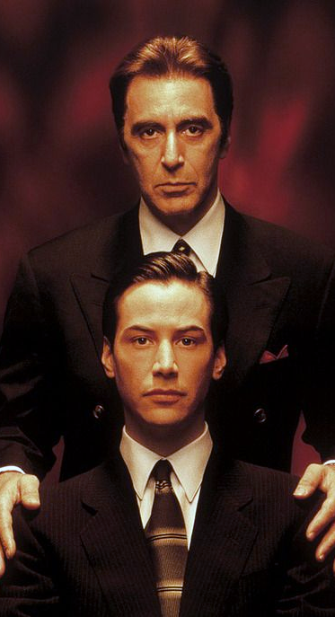

Not the Movie!
Definition: someone who, given a certain argument, takes a position they do not necessarily agree with (or simply an alternative position from the accepted norm), for the sake of debate or to explore the thought further. Or
One who argues against a cause or position, not as a committed opponent but simply for the sake of argument or to determine the validity of the cause or position.

Slide 3

A useful tool for Stewards and Business Agents
Helps to clarify positions
Calms the emotions of an argument
Fosters different perspectives
May not realize that you use it everyday
Similar to debating an issue

Slide 4
Practice for Stewards
Practice this with other stewards at your shop.
The more you play this, the better you will be able to use it with members and Employers
Must know the subject matter, no BS.
Make sure the member knows that the intent is to explore the subject, not to take sides for or against their position.

Slide 5


Exercise
Exercise: Debate on value of Right To Work Laws
The value of Right To Work Laws
The use of Weingarten Laws
Why file a grievance
The Union doesn’t serve a purpose
What other situations warrant Devil’s Advocate to be used?
Notes:
The stewards should be able to come up with more situations they see every day.

