Slide 1
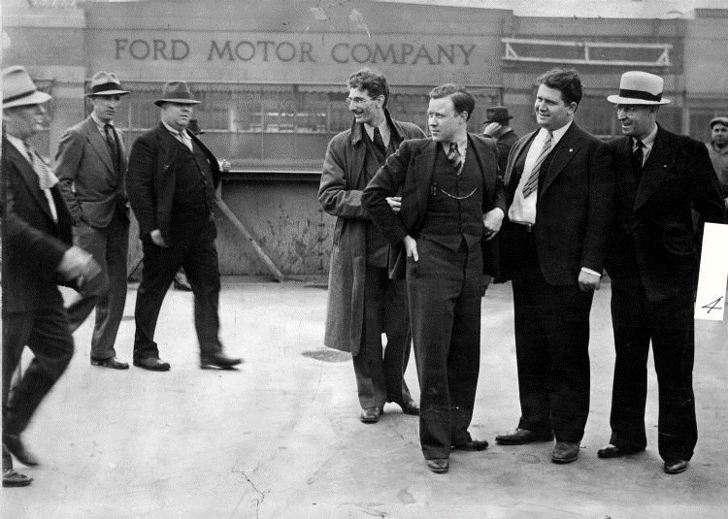


Strength
La
Future
Foundation
S
Shop Steward Series
Walter P. Reuther
Notes:
To use this title animation slide with a new image simply 1) move the top semi-transparent shape to the side, 2) delete placeholder image,
3) click on the picture icon to add a new picture, 4) Move semi-transparent shape back to original position, 5) Update text on slide.

Slide 2
Strength
Future
Foundation
Shop Steward Series
Walter P. Reuther
Notes:
To use this title animation slide with a new image simply 1) move the top semi-transparent shape to the side, 2) delete placeholder image,
3) click on the picture icon to add a new picture, 4) Move semi-transparent shape back to original position, 5) Update text on slide.

Slide 3
“There is no greater calling than to serve your fellow men. There is no greater contribution than to help the weak. There is no greater satisfaction than to have
  Done It Well.”
—Walter Reuther, United Auto Worker

Slide 4
INTRODUCTION
Our mission
  To help shop stewards reach their full capacity as strong labor advocates. Compelling others in their community to action. Holding the values and traditions of our movement.
Strength. Future. Foundation. Shop Stewards Training Series
Heroes of Labor: Leadership Building Edition.
  Exploring the history of our “Heroes of Labor”, observing what motivated them into action and what lasting impact their Legacies left behind. Gaining insight on how to build upon our own legacies.
What story do you want others to tell about you?

Slide 5
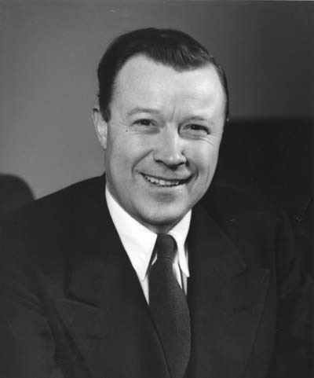
Walter P. Reuther
    President of the United Auto Workers
American
Progressive
Labor Leader
Organizer
Civil Rights Activist

Slide 6
Walter P. Reuther
    Early Life
    Born September 1, 1907, into a trade-union and socialist activist home in Wheeling, West Virginia. His father, Valentine, was a president of a Brewery local and an active socialist. He taught his children the values of trade unions and Social justice.
      The Struggle
    At the age of 16 Walter became an apprentice die and tool maker. By the time he was 19, he moved to Detroit, Michigan, taking a job at the giant Ford Motor Company. He was later fired from Ford for his organizing activity. He took the opportunity to travel the world, where he landed jobs working for auto makers in Europe and Russia. He was exposed to the struggles of workers both domestic and abroad.
    The ACTION
      Walter developed strategic organizing tactics that successfully brought the auto industry under a collective bargaining process. He gained national and international recognition through his progressive approach to labor, earning him several positions:
      President of the Union from 1946 –1970.
      President of the Congress of Industrial Organizations 1952 -1955
        Until he merged the CIO with the American Federation of Labor creating the AFL-CIO and becoming the 1st VP of the AFL-CIO.
      advisor to U.S. Presidents
    An avid Civil Rights Activist, Walter was a primary ally to Dr. Martin Luther King, Jr. and Cesar Chavez.

Slide 7
TECHNOLOGICAL REVOLUTION
Automobiles revolutionized the entire world…

Slide 8
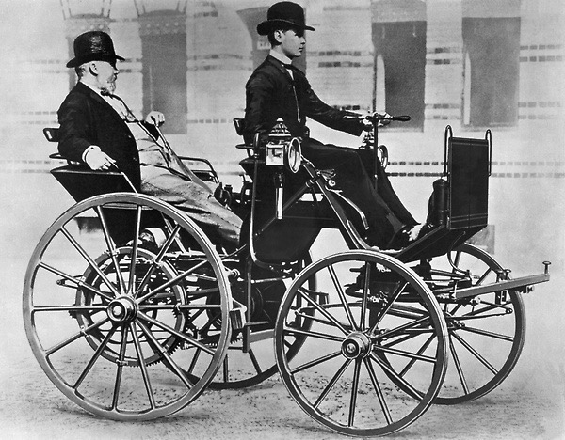
Germans and Europeans automakers had revolutionized the world with the first modern automobile in the late 1800’s.
Pictured is Gottlieb Daimler and his son Adolf on the motor car (motor carriage), 1886.
Notes:
Tip:
When using complex image as full-bleed background add a transparency (70%-90%) fill layer to give contrast to text.

Slide 9
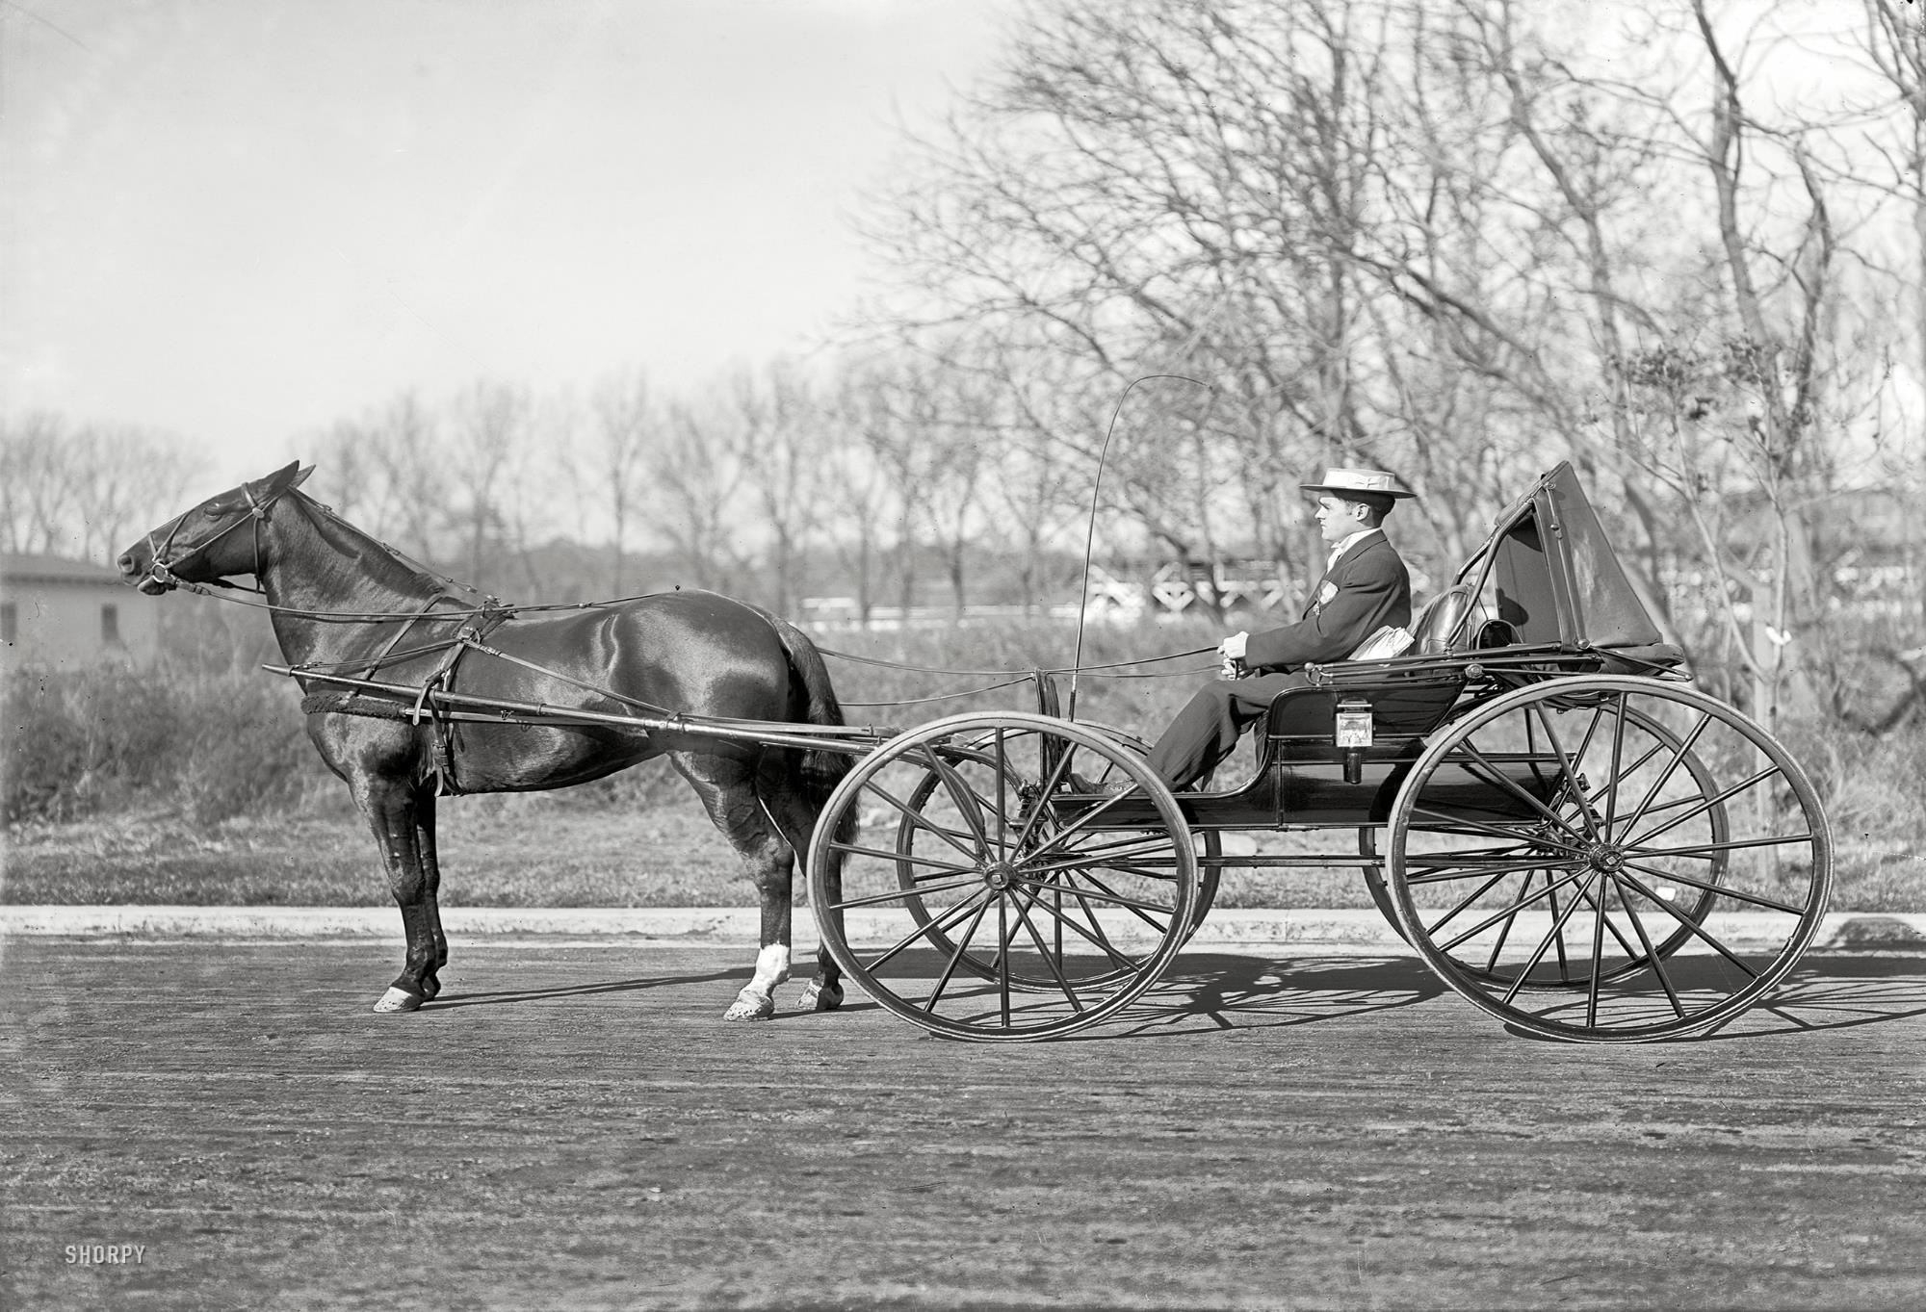
The Horse and Buggy was used prior to automobiles. The Cost was significantly higher than the automobile, especially after maintenance and storage costs.
Notes:
Tip:
When using complex image as full-bleed background add a transparency (70%-90%) fill layer to give contrast to text.

Slide 10
BIRTH OF A STRUGGLE
One man and one car birthed the struggle for Auto Workers in America…

Slide 11
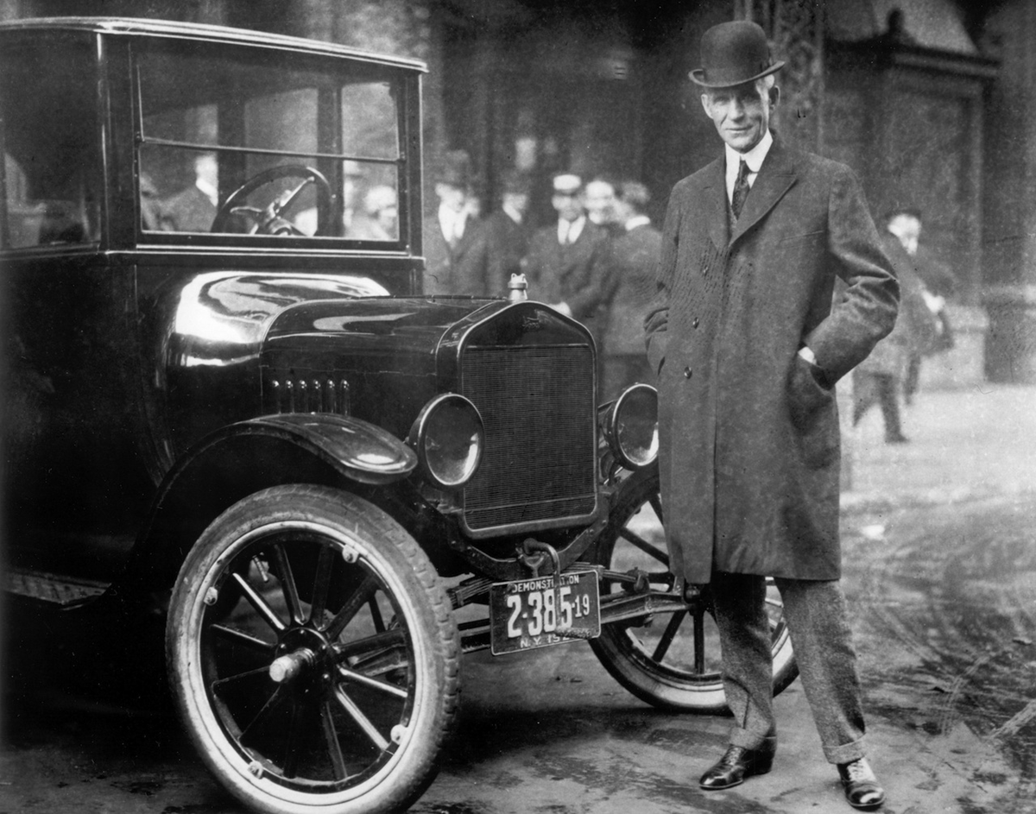
Henry Ford next to one of his early Model T Fords.

Slide 12
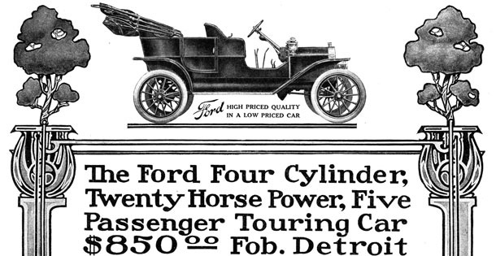
(1908 Ford Model T advertisement)
The Race to Higher Profits
  Ford had increased the production of his cars, allowing for the cost to go down. Soon more Americans would be able to buy a car. Profits increase for Ford at a record breaking pace.

Slide 13
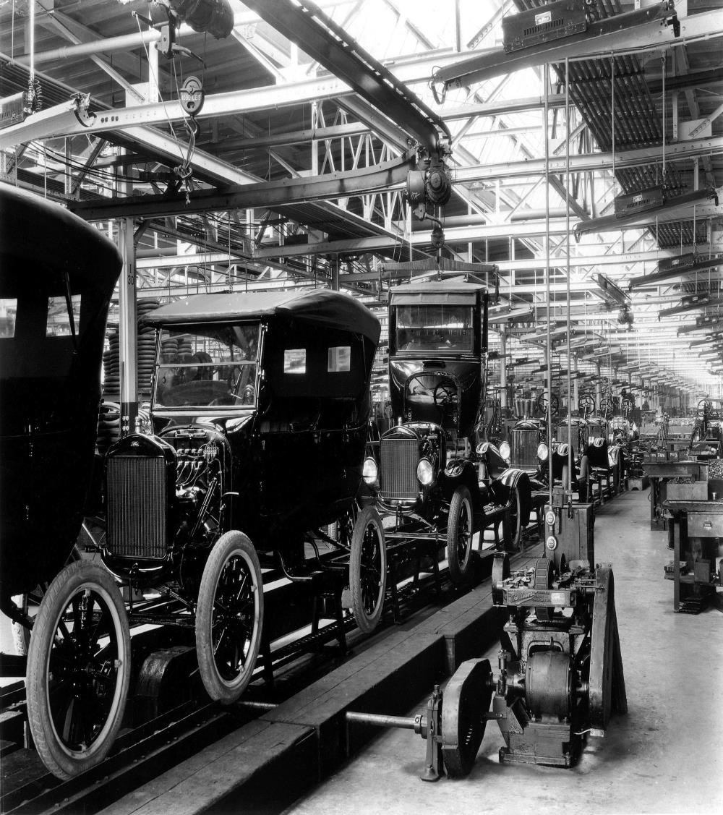
The High Cost of Affordability
Ford’s Moving Assembly Line
    The moving assembly line brought more production for the auto makers. The fast paced work now required by manufacturers often placed worker’s Safety at risk.

Slide 14

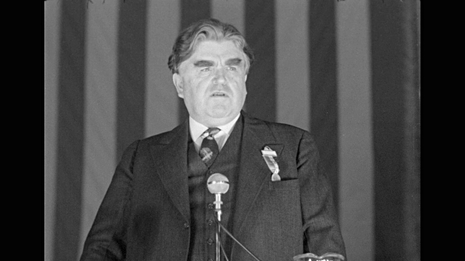
    John L. Lewis of the UMWA and CIO

Slide 15
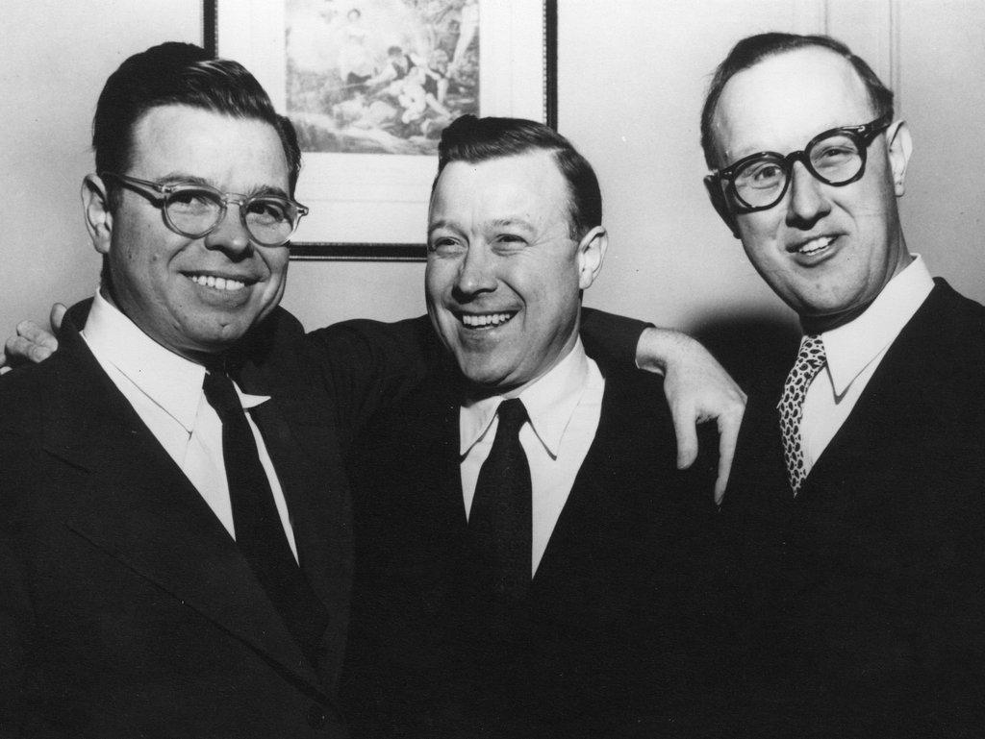
Reuther Brothers (from left) Roy, Walter and Victor
Organizing an Industry
    The Congress of Industrial Organizations (CIO), had developed a plan to organize auto workers. President John L. Lewis recruited a young organizer named Walter Reuther.

Slide 16
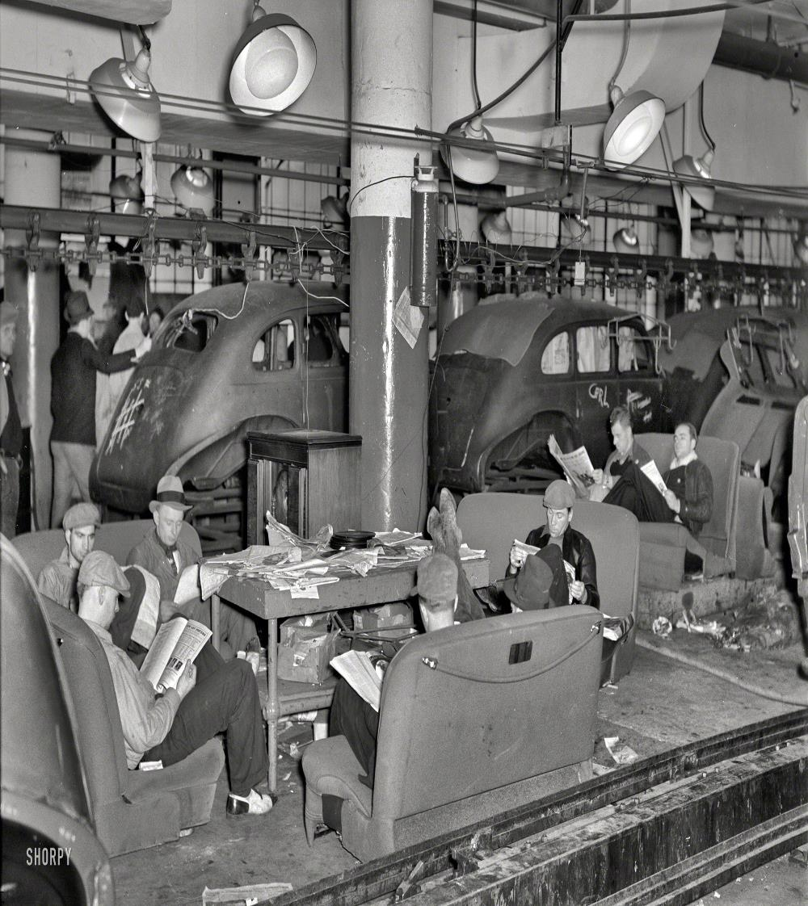
1937 Automobile Sit down Strikes
Taking it Sitting Down
    Workers at auto plant staged massive sit down strikes, stopping production and holding machinery hostage until their demands for better working conditions and higher wages were met.

Slide 17
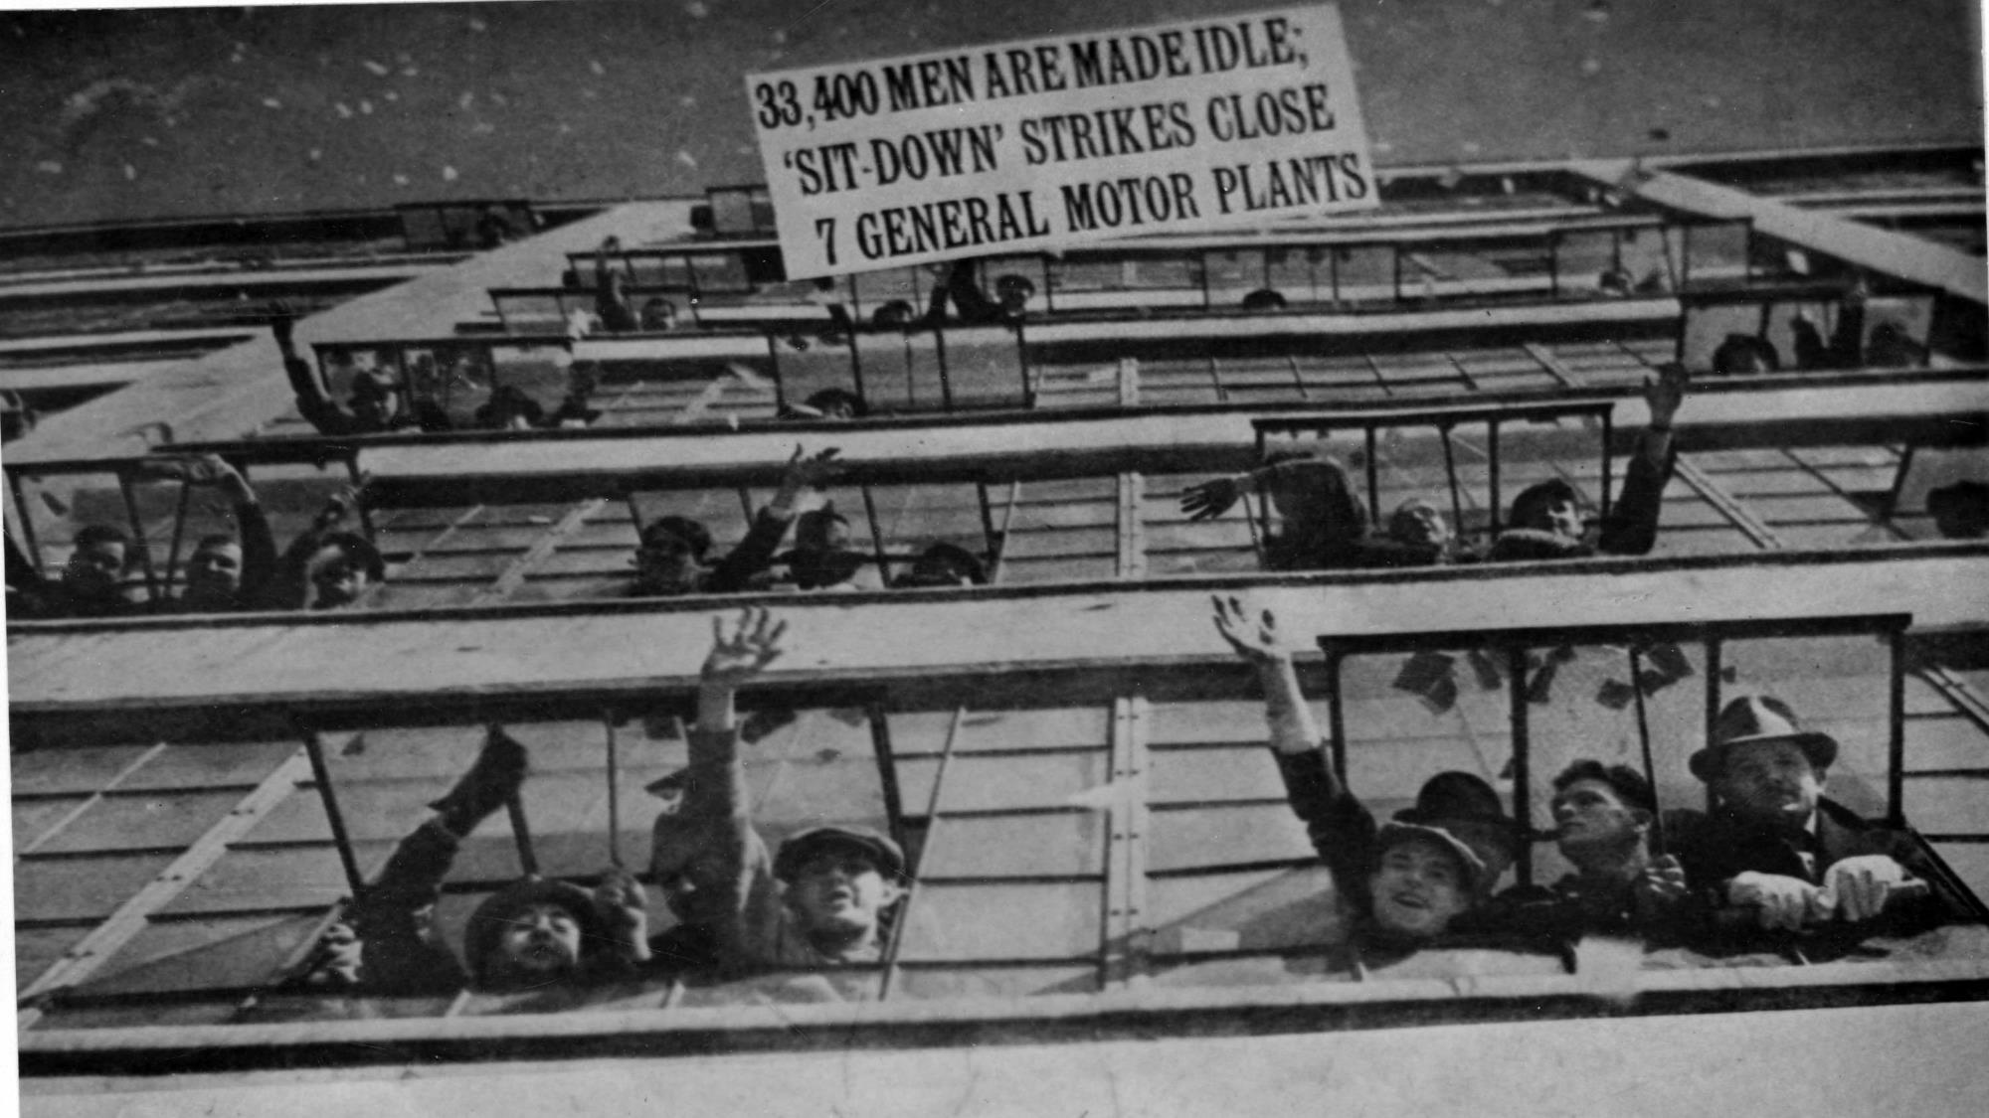
1937 - Workers waving from windows inside a General Motors plant during the Sit Down Strikes.

Slide 18
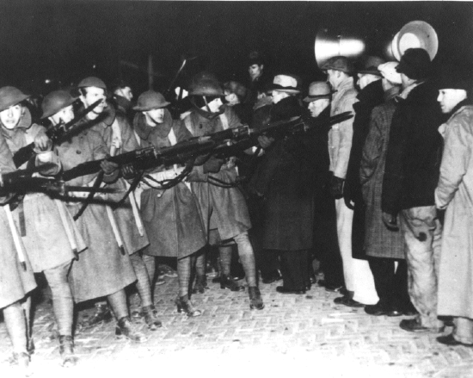
1937 – After Flint Police could not push strikers out the State deployed the National Guard.

Slide 19
FACING THE GIANT
Auto Workers were ready to face the Ford Motor Co.

Slide 20
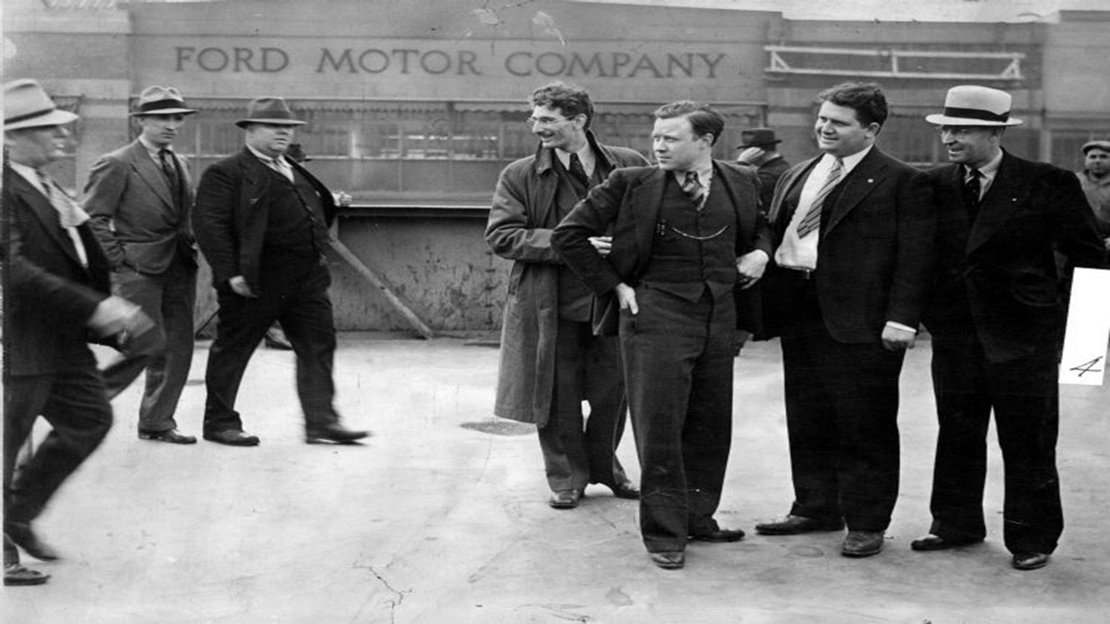
May 26, 1937 “Battle of the Overpass” (Pictured are Harry Bennet’s goons, far left, and Union organizers, including Walter Reuther and Richard Frankensteen, Right center).

Slide 21
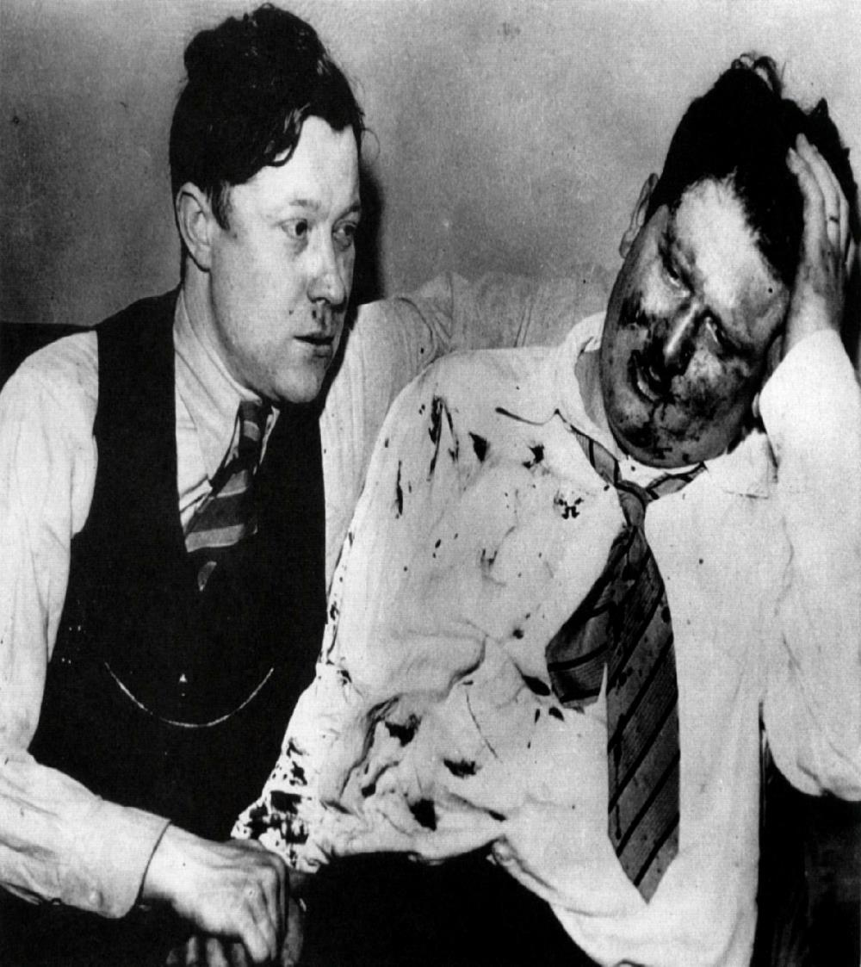
Pictured is Walter Reuther and Richard Frankensteen, in one of the photos from the only surviving roll of film taken at the “Battle of the Overpass”, after being beaten and thrown down a flight of stairs by Harry Bennet’s Private police outside the Ford Rouge Plant.
National Exposure
    Until “The Battle of the Overpass”, many American’s were oblivious to the tactics used by the Ford Company and it’s labor advisor, Harry Bennet.

Slide 22
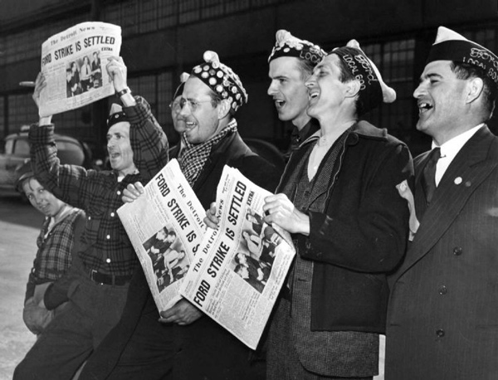
Victory at Ford
    Ford had been the last of the Big 3 auto makers to come under a Union contract with the UAW. On June 20, 1941, Henry Ford signed the Agreement with the UAW. It would be come the best Agreement in the entire industry.

Slide 23
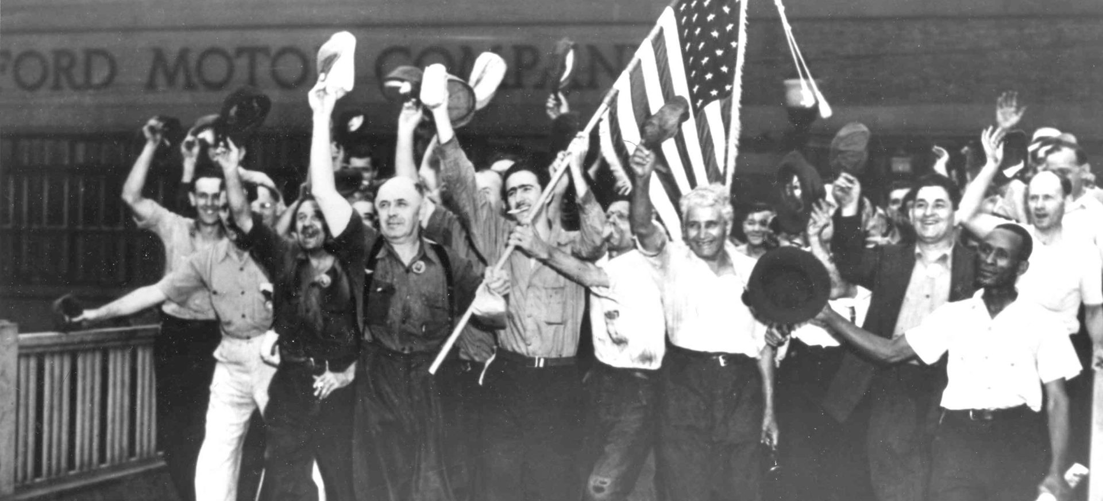
June 20, 1941, The Ford Strike was settled by Henry Ford signing the 1st Union Contract with his workers and the UAW.

Slide 24
Walter Reuther a life DONE WELL.
CONCLUSION

Slide 25
STRUGGLE
        Walter had been met with challenges from an early age.
ACTION
        Walter met those challenges with action.
INSPIRE
        Walter was inspired by his life’s experiences and inspired others to action.
Notes:
Combine an image and multiple key statements with a strong grid.

Slide 26
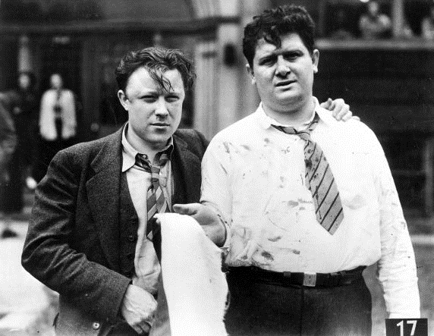

Slide 27
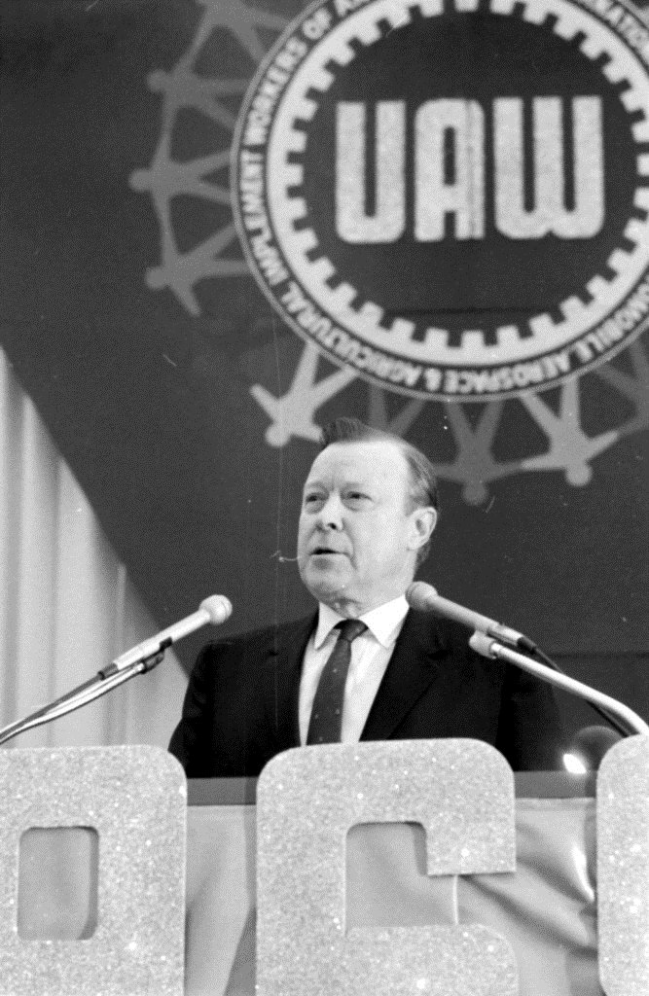
Taking it Sitting Down
    Workers at auto plant staged massive sit down strikes, stopping production and holding machinery hostage until their demands for better working conditions and higher wages were met.

Slide 28
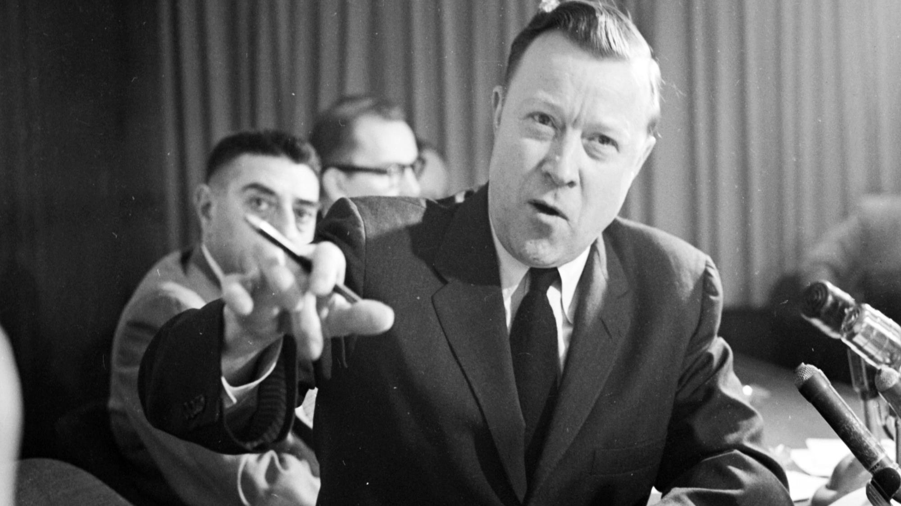
Taking it Sitting Down
    Workers at auto plant staged massive sit down strikes, stopping production and holding machinery hostage until their demands for better working conditions and higher wages were met.

Slide 29
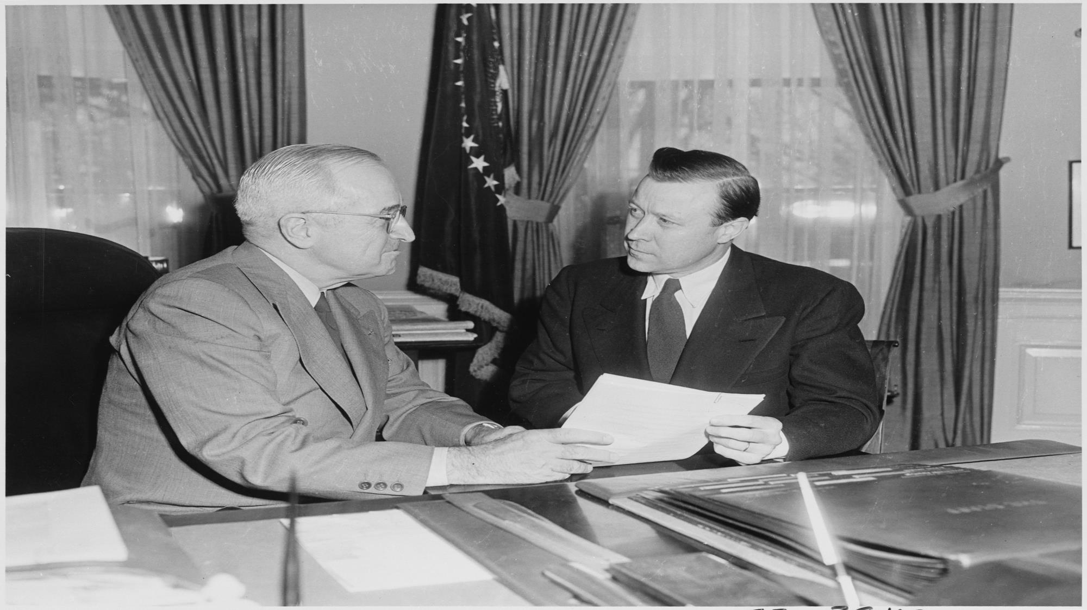
Taking it Sitting Down
    Workers at auto plant staged massive sit down strikes, stopping production and holding machinery hostage until their demands for better working conditions and higher wages were met.

Slide 30
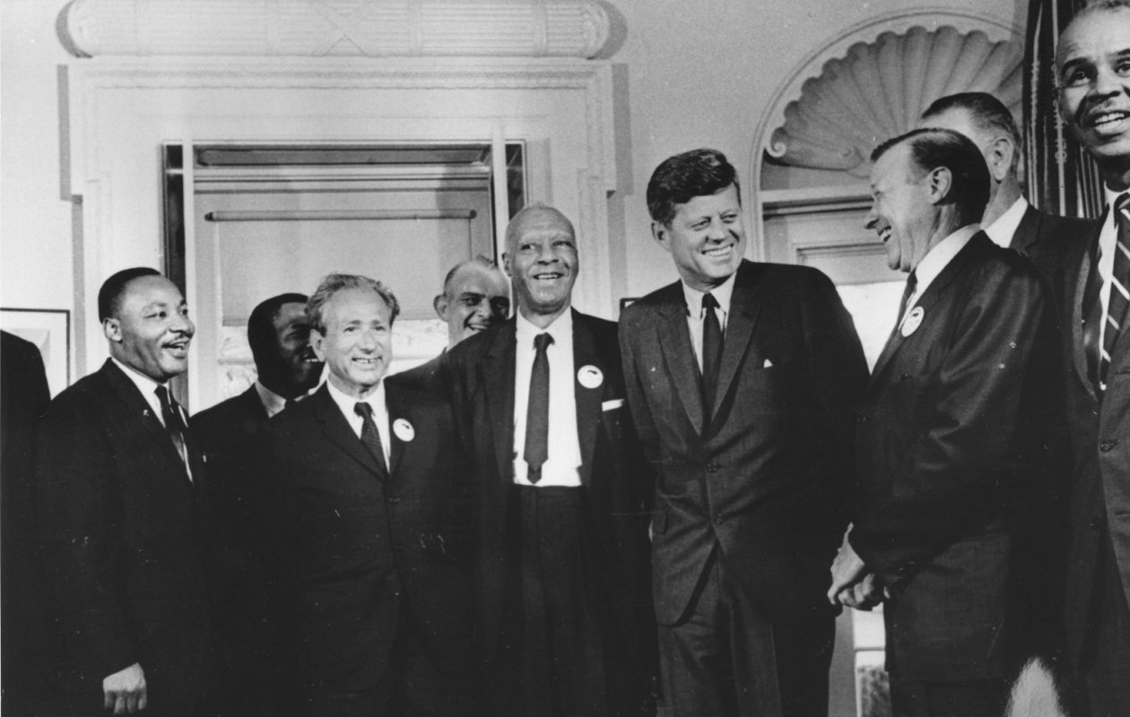
Taking it Sitting Down
    Workers at auto plant staged massive sit down strikes, stopping production and holding machinery hostage until their demands for better working conditions and higher wages were met.

Slide 31
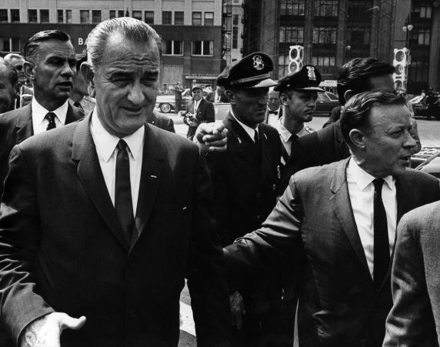
Taking it Sitting Down
    Workers at auto plant staged massive sit down strikes, stopping production and holding machinery hostage until their demands for better working conditions and higher wages were met.

Slide 32
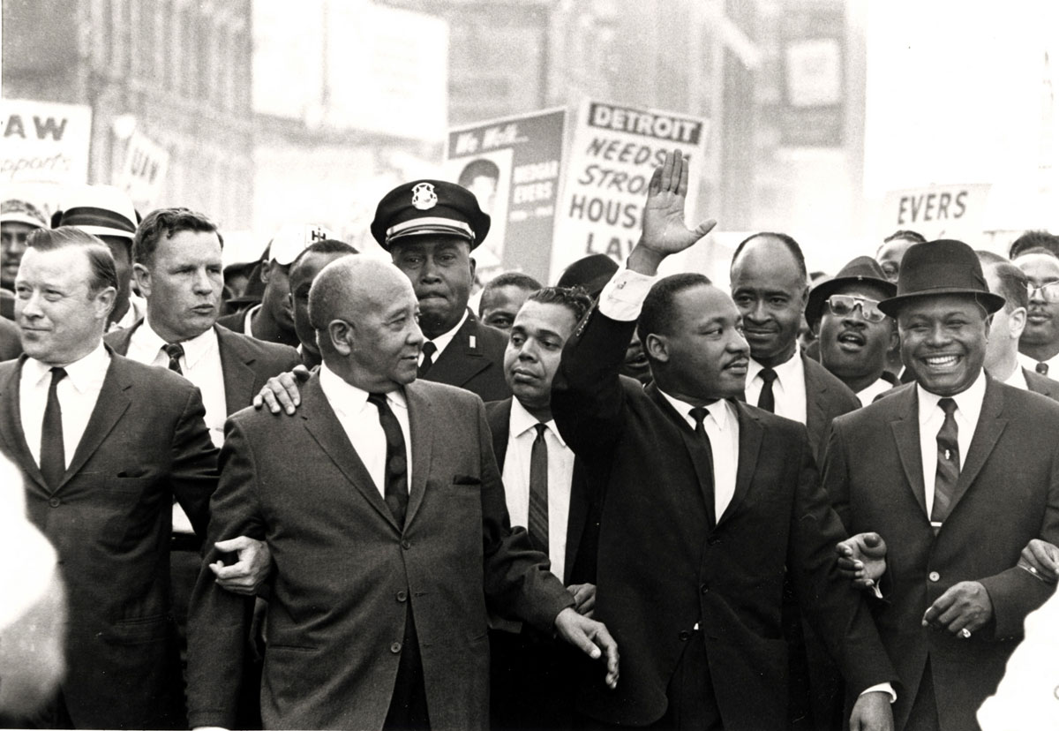
Taking it Sitting Down
    Workers at auto plant staged massive sit down strikes, stopping production and holding machinery hostage until their demands for better working conditions and higher wages were met.

Slide 33
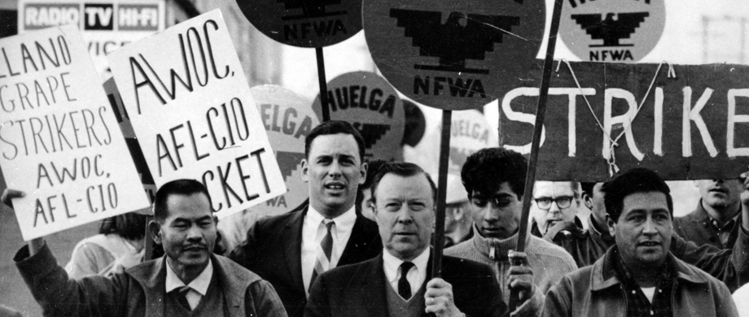
Taking it Sitting Down
    Workers at auto plant staged massive sit down strikes, stopping production and holding machinery hostage until their demands for better working conditions and higher wages were met.

Slide 34
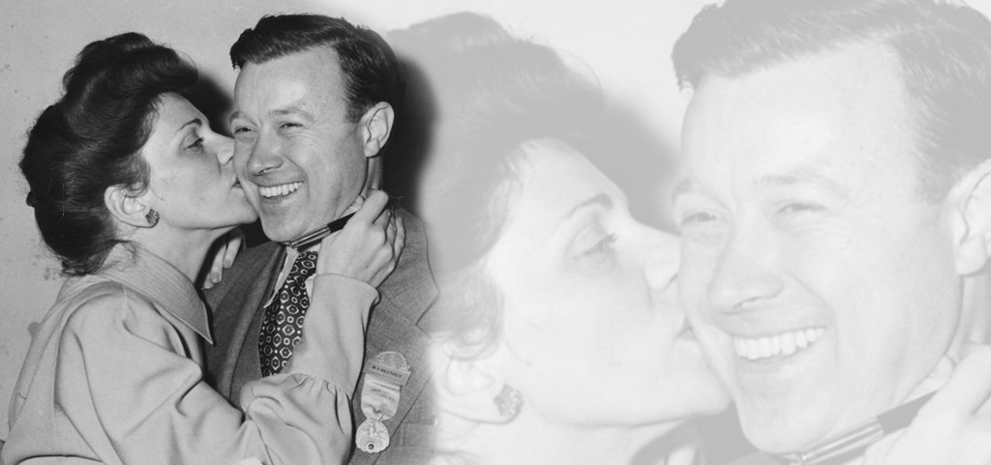
                on May 9, 1970, Walter Reuther and his wife, May, were tragically killed in a plane crash. Flags were flown at half mass on top of government buildings across the country and at all three of the Big 3 auto companies. During the May 12th funeral, UAW members at over 300 plants across the U.S. and Canada turned off their machines and halted assembly lines for three minutes to honor their fallen leader, In an unprecedented show of respect and solidarity.
Taking it Sitting Down
    Workers at auto plant staged massive sit down strikes, stopping production and holding machinery hostage until their demands for better working conditions and higher wages were met.

Slide 35
Take a ways
World Famous Shop Steward Evaluation
“How has your struggle shaped you?”
  Consider your life’s experiences—how have they developed you into the LEADER you are today.
“How has that struggle caued you to Action?”
  Reflecting on challenges you have faced—how have your Actions changed your course of your leadership.
“How have you Inspired others into Action?”
  Focus on your Leadership—how have you impacted those around you. What is your influence level.

Slide 36
My main point is that the labor movement is about that problem we face tomorrow morning… But to make that the sole purpose of the labor movement is to miss the main target.
  The labor movement is about changing society.
—Walter Reuther

Slide 37
This has been a
Strength… Future…
Foundation…
Shop Steward Training
THANK YOU

